Slide 1
Attitude and stress unit-6

Slide 2
Attitude
Relatively enduring and general evaluation of an object, person, group, issue, or concept on a dimension ranging from negative to positive

Slide 3
Components of Attitude
1. Cognitive component: It refers to the beliefs, thoughts, and attributes that people associate with a particular object.
• A person's attitude is frequently influenced by the negative and positive characteristics they associate with an object.
• It is the cognitive part of an attitude that we are talking about when we form our opinion or judgement based on available information and decide whether we have a favourable or unfavourable opinion on it.
2. Affective component: The affective component of attitudes is linked to people's feelings or emotions (e.g., fear, sympathy, hate, like, and pleasure).
• Affective responses have a variety of effects on attitudes.
• Many people, for example, are afraid of spiders. As a result of this negative affective response, you're likely to have a negative attitude toward spiders.
• Affect plays a crucial role in the formation of attitudes.
• Affect is also a common factor in changing one's mind. Purely cognitive rationales may be overridden by how we feel about a result.
3. Behavioural component: A tendency or predisposition to act in a certain way is referred to as the behavioural (or conative) component of attitudes.
o Affective and cognitive factors may contribute to a person's proclivity to behave in a certain way.

Slide 4
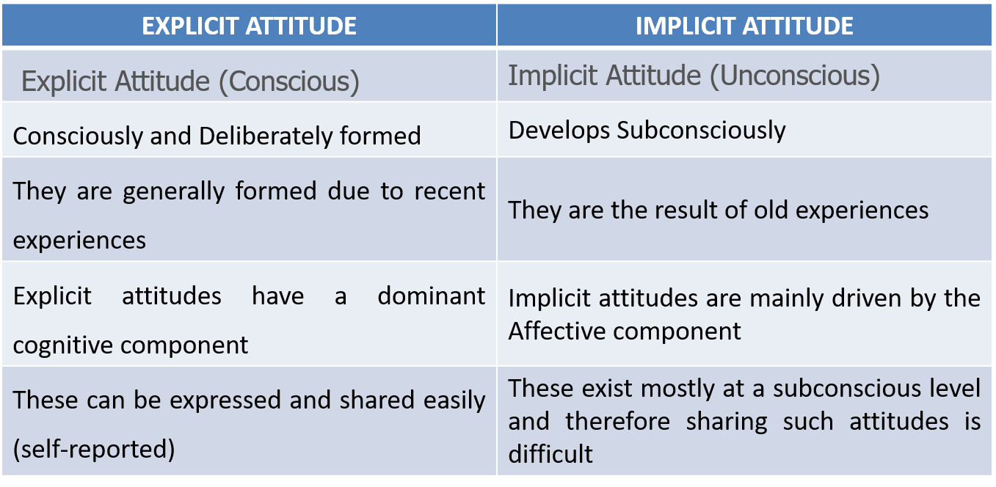

Slide 5
Attitudes – characteristics (nature)
Learned: Attitudes are not innate but are acquired over time through personal experiences and social interactions.
Evaluative: All attitudes are evaluative in nature, expressing a positive, negative, or neutral judgment about something.
Directional: Attitudes are directed toward specific objects, people, ideas, or events.
Indirectly Observable: While attitudes are internal psychological phenomena, they can be inferred by observing a person's behavior and expressions.
Motivational: Attitudes provide a motivational property that directs our behavior and efforts in a particular direction. Attitudes influence our perceptions, judgments, and behaviors, guiding how we interact with the world around us.

Slide 6
Development of Attitude
Several factors can influence how and why attitudes form, including:
Experience
Attitudes form directly as a result of experience. They may emerge due to direct personal experience, or they may result from observation.
2. Social Factors
Social roles and social norms can have a strong influence on attitudes. Social roles relate to how people are expected to behave in a particular role or context. Social norms involve society's rules for what behaviors are considered appropriate
3. Observation
Finally, people also learn attitudes by observing people around them. When someone you admire greatly espouses a particular attitude, you are more likely to develop the same beliefs.

Slide 7
Stress
Our response to events that disrupt, or threaten to disrupt, our physical or psychological functioning
-(Lazarus & Folkman, 1984).

Slide 8
Types of Stress
Types of Stress
1. Acute Stress
Short-term stress that arises from immediate challenges (e.g., exams, deadlines).
2. Episodic Acute Stress
When acute stress happens repeatedly and frequently; the person often feels “always under pressure.”
3. Chronic Stress
Long-term, continuous stress caused by ongoing problems (e.g., poverty, illness, family conflict).
4. Physical Stress
Stress due to physical factors like injury, illness, lack of sleep, or excessive work.
5. Psychological Stress
Stress caused by emotional or mental factors such as fear, worry, frustration, or conflict.
6. Environmental Stress
Stress due to surroundings—noise, pollution, crowding, extreme temperatures.
7. Traumatic Stress
Stress resulting from extreme events like accidents, disasters, or violence.

Slide 9
Types of Stress
Types of Stress
Positive stress {eustress}
Negative stress {distress}

Slide 10
Stressors
Stressors are any events, situations, or conditions that cause stress or trigger a stress response in a person

Slide 11
Types of Stressors
1. Physical Stressors
Factors that affect the body.
Examples: injury, illness, noise, extreme temperature.
2. Psychological Stressors
Emotional or mental pressures.
Examples: fear, anxiety, exams, conflicts.
3. Environmental Stressors
Stress caused by surroundings.
Examples: pollution, crowding, loud sounds, traffic.
4. Social Stressors
Related to relationships or society.
Examples: arguments, peer pressure, family issues.
5. Daily Hassles
Small everyday problems that accumulate.
Examples: being late, workload, misplacing things.
6. Life Events
Major changes in life.
Examples: marriage, divorce, job loss, relocation.
7. Traumatic Stressors
Severe, life-threatening events.
Examples: accidents, natural disasters, violence.

Slide 12
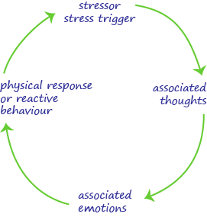
Stress Cycle

Slide 13
Stress Cycle / General Adaptation Syndrome (GAS)
General Adaptation Syndrome (GAS) is a model developed by Hans Selye in the 1950s to describe the body’s physiological response to stress.
1. The Alarm Phase (Initiation of Stress Response)
When a person perceives a threat or challenge—known as a stressor—the body immediately activates the sympathetic nervous system. This triggers the fight-or-flight response, during which the adrenal glands release hormones such as adrenaline (epinephrine) and cortisol. Physiological changes occur, including increased heart rate, heightened alertness, muscle tension, and rapid breathing. These responses prepare the body to confront or escape the stressor.
2. The Resistance Phase (Adaptation)
If the stressor persists, the body enters a phase of sustained arousal to cope with the ongoing demand. Cortisol levels remain elevated to provide energy and maintain alertness. During this stage, the individual attempts to adapt to the situation through coping mechanisms such as problem-solving or emotional regulation. However, prolonged activation of the stress response without adequate recovery can begin to strain physiological systems.
3. The Exhaustion Phase (Depletion and Breakdown)
When stress continues for an extended period without resolution, the body’s adaptive energy becomes depleted. Chronic exposure to stress hormones can weaken the immune system, disrupt sleep, and impair cognitive and emotional functioning. This phase is often associated with burnout, fatigue, anxiety, and various stress-related illnesses such as hypertension or depression.

